Slide 1
Documentation Lead Presenation
By: Taisann Kham
Team: Apple

Slide 2
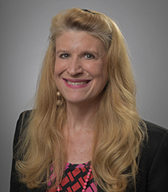
Client: Evelyn R. Brannock
Our client is Evelyn R. Brannock, assistant professor of information technology at GGC. As an ITEC professor, one of her responsibilities includes acting as Administrator of GGC’s current manual scheduler for faculty courses, and it is our responsibility to create a better scheduler that makes faculty registration quicker and more efficient.

Slide 3
Client: Evelyn R. Brannock
Our client is Evelyn R. Brannock, assistant professor of information technology at GGC. She has two decades of experience in ITEC and specializes in watermarking, bioinformatics, software engineering, and model driven architecture. As an ITEC professor, one of her responsibilities includes acting as Administrator of GGC’s faculty course scheduler.

Slide 4



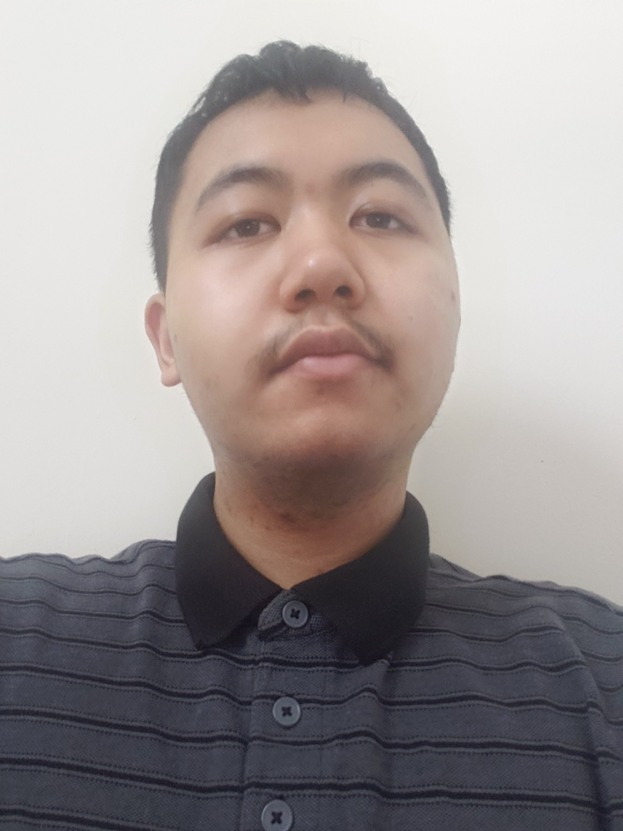
Team Apple

Slide 5
Plan for User Documentation
GitHub will store Documentation for Users and Developers
Developers:
Requirements Documentation
License Documentation
Intellectual Property Documentation
Future Improvements Document
Users:
Faculty Guide Documentation
Admin Guide Documentation

Slide 6
Developer Documentation
Requirements Documentation
Functional, Non-Functional, and Domain Requirements specified by the client
License Documentation
Licensing and copyright info about the fair use and modification of the product
Intellectual Property Documentation
Agreement of ownership between Team Apple members and client
Future Improvements Documentation
In-depth explanation of unfinished parts of the product
Tells why something is wrong, why it needs to be improved, and what methods didn’t work

Slide 7
User Documentation#1???
Faculty Guide Documentation
Explains what each page does on the Faculty side
Admin Guide Documentation
Explains what each page does on the Admin side

Slide 8
User Documentation#2???
Faculty Guide Documentation
Explains what each page does on the Faculty side
Admin Guide Documentation
Explains what each page does on the Admin side

Slide 9
FORMATTING AUTODOCS???

Slide 10
Documentation Organization
Team Apple’s documentation will be located in the “doc_Apple” folder to separate it from the previous team’s documents “doc_CyberATL”.

